Slide 1
Seminar assignment, group International ports
Each group has material to be able to make a 10-15 minute presentation about their port
The presentation can be carried out with powerpoint . It is fine to include small video clips in the presentation
The entire group must be familiar with all parts of the work.
the presentation through a cross-group presentation where each group tells about their port. The presentation should NOT be read aloud .
2 groups in each meeting.
The groups present their work to each other. Each meeting takes about 30 minutes
Each group makes its presentation 3 times.

Slide 2
International ports
Operations and Capacity
Ship - Fartyg
Container -
Bulk, energy - Bulk, energi
Cruise - Kryssning
Other
Infrastructure
Railway - Järnväg
Ways - Vägar
Short sea shipping, barge ( barge ) - Närsjöfart, pråm (barge)
Pipelines
Describe the port's range of services. - utbud av tjänster

Slide 3
International ports
Group 1 Rotterdam https://www.portofrotterdam.com/en
Group 2 Hamburg https://www.hamburg.com/port/
Group 3 Los Angeles https://www.portoflosangeles.org/
Group 4 Hong Kong https://www.hkmpb.gov.hk/en/port.html https://en.wikipedia.org/wiki/Port_of_Hong_Kong
Group 5 Antwerp https://www.portofantwerp.com/en
Group 6 Jebel Ali https://www.dpworld.com/en/uae

Slide 4
Operations and Capacity
Cargo Handling
Container Terminal
Capacity
Connectivity
Technology and Innovation
Environmental Initiatives
Trade and Economic Impact
Notes:
As of my last update in January 2022, the Port of Hamburg is a versatile and multifaceted port, capable of handling various types of cargo and vessels. Here's an overview of its operations and capacity across different sectors:
1. **Container Handling**:
- The Port of Hamburg is a major container hub in Europe, handling a substantial volume of containerized cargo. Its container terminals are equipped with modern facilities and handling equipment.
- The capacity for container handling has seen expansions and upgrades over the years to accommodate the growing volume of containers passing through the port.
2. **Bulk Cargo Handling**:
- The port deals with different types of bulk cargo, including coal, grains, ores, and other bulk commodities. There are dedicated facilities and terminals equipped for efficient bulk cargo handling.
3. **Energy Sector**:
- Hamburg's port has facilities for handling energy-related cargo, including liquid bulk such as petroleum products, chemicals, and other energy commodities.
- It might have facilities for LNG (liquefied natural gas) or other energy-related infrastructures to support the growing demand for cleaner energy sources.
4. **Cruise Operations**:
- The Port of Hamburg serves as a popular cruise destination and operates cruise terminals to accommodate cruise ships.
- It caters to both transit cruises and turnaround cruises, offering facilities for passenger embarkation/disembarkation and services to support cruise operations.
5. **Other Operations**:
- The port handles general cargo, project cargo, and specialized cargo requiring specific handling facilities.
- It may have terminals or facilities dedicated to Ro-Ro (Roll-on/Roll-off) operations for vehicles and other similar cargo.
6. **Logistics and Connectivity**:
- Hamburg port is well-connected to inland transportation networks, including rail and road networks, to ensure efficient movement of goods to and from the port.
- It has developed as a significant logistics hub, offering a range of services beyond cargo handling, including warehousing, distribution, and value-added logistics solutions.
7. **Environmental Initiatives**:
- There's a focus on sustainability and environmentally friendly practices in port operations, aiming to reduce emissions, adopt cleaner technologies, and promote eco-friendly initiatives across various sectors within the port.
The operations and capacities in each sector can vary based on ongoing developments, expansions, and changes in demand. For the most current and specific details regarding operations and capacities in each sector at the Port of Hamburg, I recommend consulting official port authorities or the latest reports and publications available from the port administration.

Slide 5
Ship - Fartyg

Slide 6
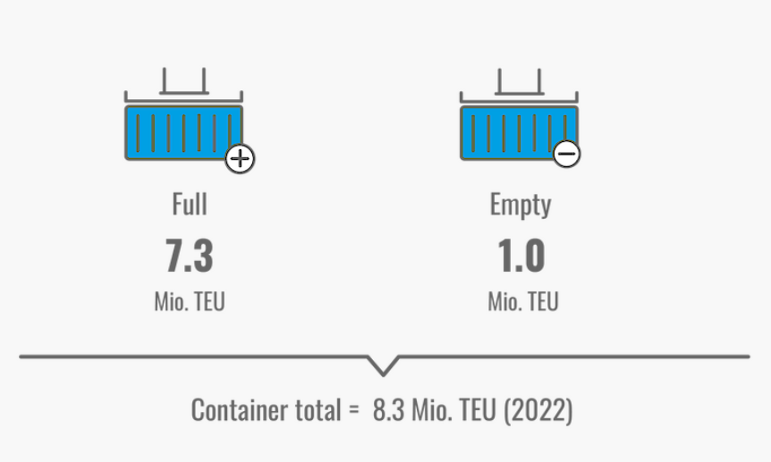
Container
Notes:
Container Handling
Dominant segment at Port of Hamburg.
HHLA’s container terminals Altenwerder, Burcharkai and Tollerort
as well as the Eurogate terminal clearly show how important
A total of 8.3 million TEUs crossed quay walls in the Port of Hamburg in 2022.
Decline of 5.1% compared to 2021
With just under 82.3 million tonnes transported, container handling thus accounts for around 70 percent of total handling.
The share of container cargo in total general cargo handling is almost 99%.
Loaded containers make up more value-added part of container handling.
7.3 million loaded TEUs, account for almost 88% of total container throughout (8.3 million TEUs).
Around 99000 TEU were handled empty in 2022.

Slide 7
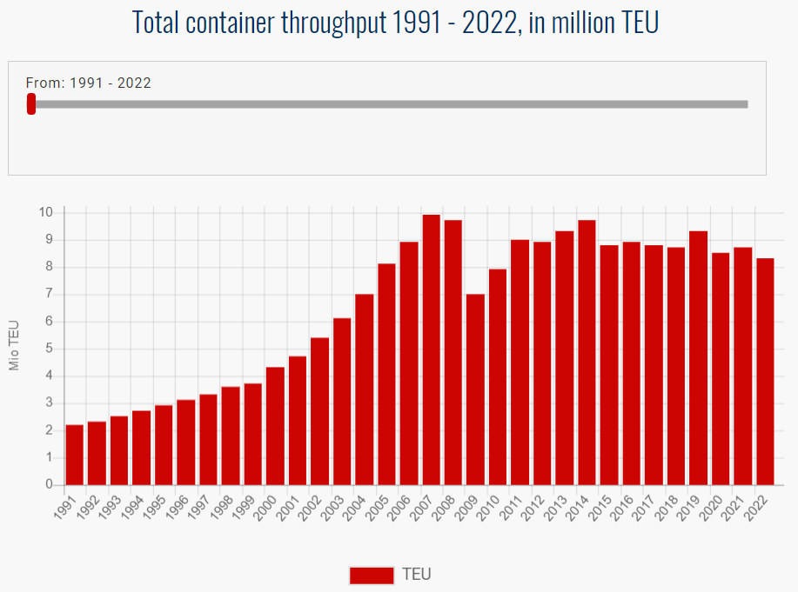
Notes:
https://www.investopedia.com/terms/t/throughput.asp
Throughput, in business, is the amount of a product or service that a company can produce and deliver to a client within a specified period of time. The term is often used in the context of a company's rate of production or the speed at which something is processed.
High throughput = produce product or service more efficiently

Slide 8
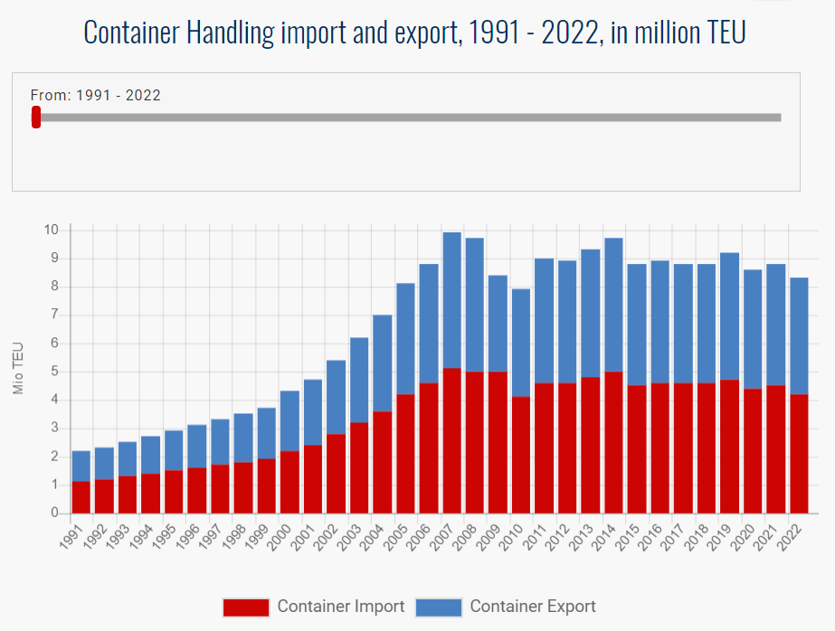

Slide 9
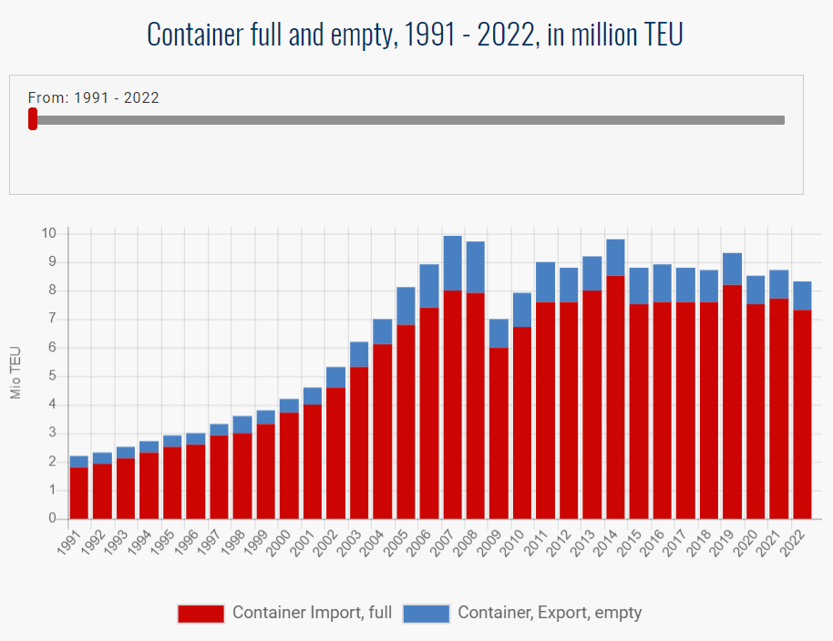

Slide 10
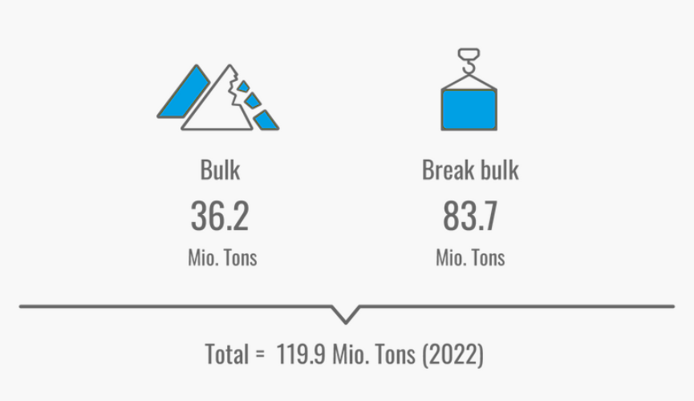
Cargo Handling
Notes:
Germany’s largest universal port has a seaborne cargo throughput of 119.9 million tons for 2022
Total throughput of the port is the sum of two major segments bulk cargo and general cargo.
In 2022, international crises impacted the Port of Hamburg’s seaborne cargo throughput.
The war in Ukraine plus the related sanctions against Russia, along with worldwide supply chain problems caused by the corona pandemic, impacted Port of Hamburg throughput during the year.
In 2022, 119,9 million tonnes of seaborne Goods were loaded or unloaded at the terminals in Germany’s largest universal port.
-6.8% compared to 2021.
5.8% decline to 83.7 million tonnes in general cargo throughput.
8.9% decline to 36.2 million tonnes in bulk cargo handling.

Slide 11
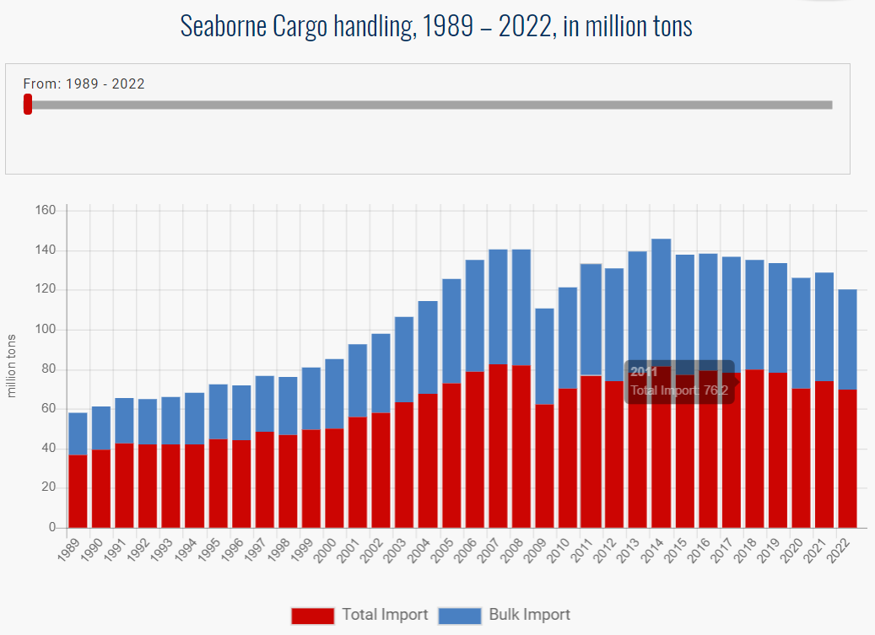

Slide 12
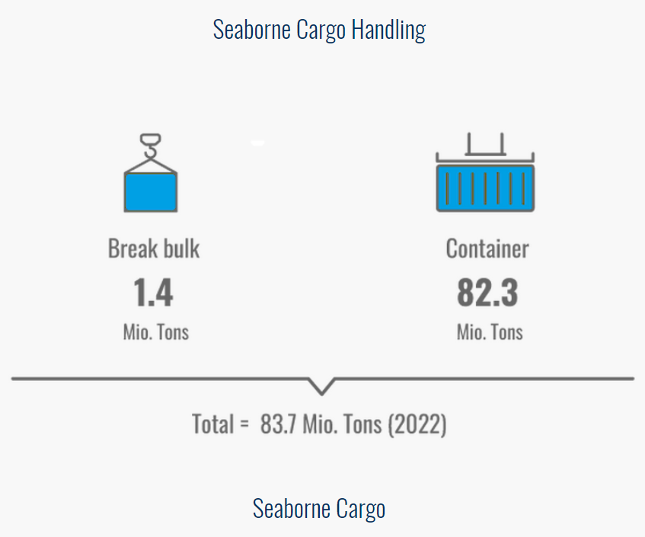

Slide 13
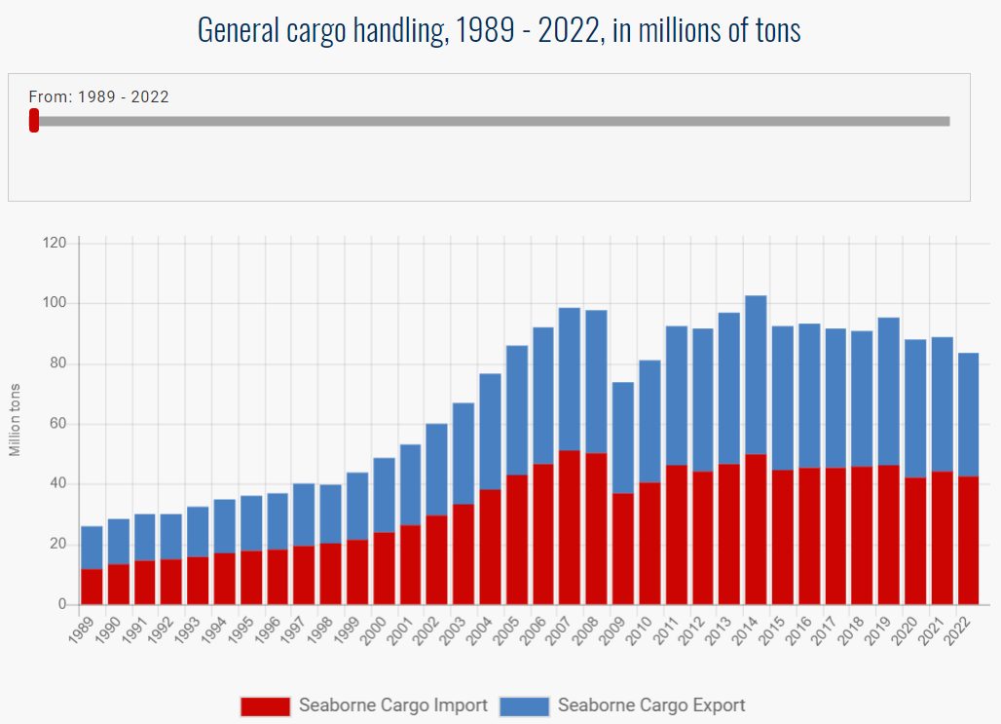

Slide 14
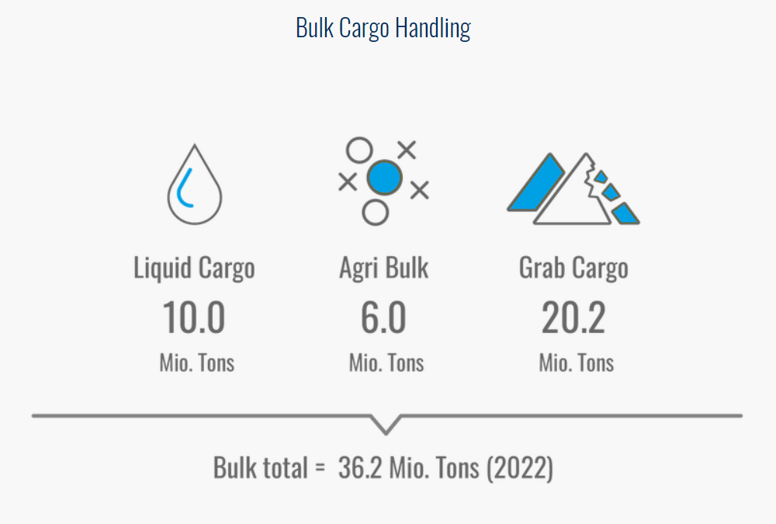

Slide 15
